Slide 1
Keylogger
By Ashton Toler, Kelli Kinnikin, Nick Fresta

Slide 2
What Is a Keylogger
Keylogging is the act of recording key presses on a keyboard, a technique that can be used by snoops and hackers to obtain passwords and other sensitive information.
Keyloggers come in both software and hardware varieties. Hardware keyloggers plug into either a USB or PS/2 port and the keyboard is then plugged into the keylogger.

Slide 3
History
Keylogging predates the era of personal computers, with hardware-based keyloggers being used in typewriters as early as the 1970s. For example Russian spies found a way to bug IBM Selectric typewriters used by US diplomats, transmitting the keystrokes via radio frequency.

Slide 4
How they work
Main idea behind keyloggers is to get in between any two links in the chain of events between when a key is pressed and when information about that keystroke is displayed on the monitor.
a hardware bug in the keyboard, wiring or the computer itself, intercepting input/ output, substituting the keyboard driver, the filter driver in the keyboard stack, intercepting kernel functions by any means possible (substituting addresses in system tables, splicing function code, etc.), intercepting DLL functions in user mode, and, finally, requesting information from the keyboard using standard documented methods.

Slide 5
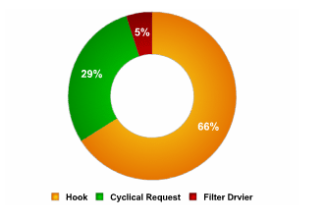
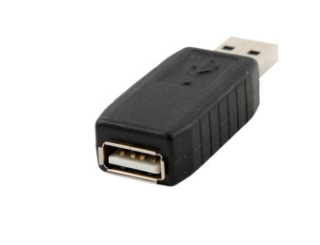
Software and Hardware
a system hook which intercepts notification that a key has been pressed
a cyclical information keyboard request from the keyboard (using WinAPI Get(Async)KeyState or GetKeyboardState – most often written in Visual Basic, sometimes in Borland Delphi);
using a filter driver (requires specialized knowledge and is written in C).

Slide 6
How They Spread
a keylogger can be installed when a user opens a file attached to an email;
a keylogger can be installed when a file is launched from an open-access directory on a P2P network;
a keylogger can be installed via a web page script which exploits a browser vulnerability. The program will automatically be launched when a user visits a infected site;
a keylogger can be installed by another malicious program already present on the victim machine, if the program is capable of downloading and installing other malware to the system.

Slide 7
Our Key Logger Story

Slide 8
Live Demo

Slide 9
What we Learned

Slide 10
How to Gaurd Against Keyloggers
Physically secure public computers and disable unused USB ports so hardware keyloggers can't be used
Use anti-malware that can detect software keyloggers
Never use a public computer to log on to any websites or services that require you to enter a password
Restrict users to privileged accounts to prevent them from installing software on their machines
Periodically check desktop computers for the presence of hardware keyloggers
Wipe systems if they are compromised by software keyloggers
Don't ever install questionable software that could contain malware
Beware of suspicious changes to physical devices or peripherals, such as the keyboard itself, that might have been hacked
When possible, use two-factor authentication on your accounts to add an extra layer of protection, in case your password gets hacked

Slide 11
Conclusion

Slide 12
Resources
https://community.spiceworks.com/topic/2003395-what-is-keylogging-definition-history-and-how-to-detect-word-of-the-week
https://securelist.com/keyloggers-how-they-work-and-how-to-detect-them-part-1/36138/

